Slide 1
The soldering station
Lukas Lipkens
Notes:
Greet everyone and tell them your name

Slide 2
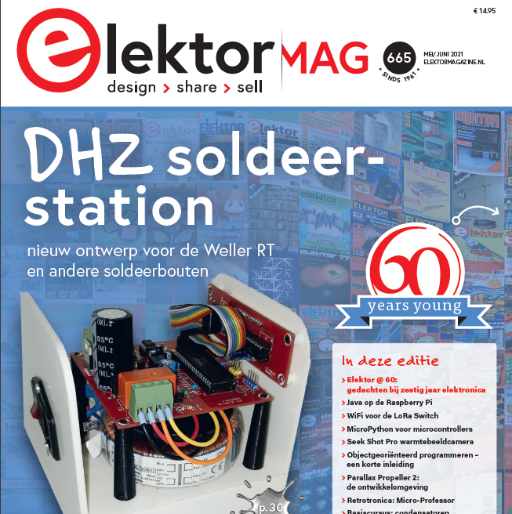
The Project
Notes:
So the soldering station was recommended by my teacher Mister hilven, this immediately looked like a very cool and useful project mainly because it could be used to solder the pcb’s of future projects. Also the entire project was laid out by elektor, this is an enthusiast electronics magazine that included all of the schematics and a bill of materials for the station which was very handy to use because this was my very first electronical project. It also briefly explained how everything worked.

Slide 3


Software
Notes:
Throughout this project Altium designer and Fusion 360 are used to design everything,
Altium designer is used to design every aspect of the PCB, from schematic to the PCB itself
Fusion 360 is used to design the entire mechanical design for the project

Slide 4
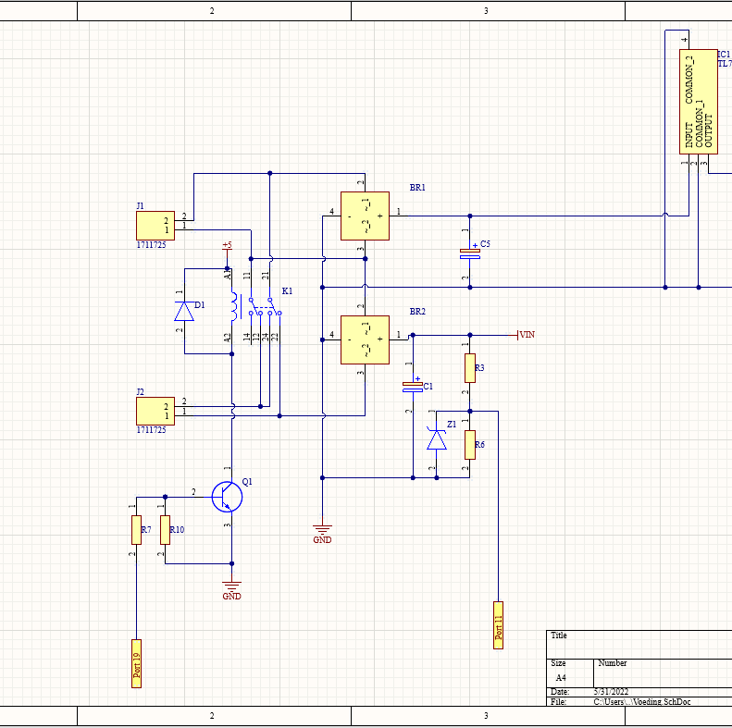
The schematic design
Power circuit
Processor
OPAMP
Display
Iron power
Notes:
So once the decision to make the soldering station I immediately started on the electrical schematics.
MADE IN ALTIUM DESIGNER
SPLIT INTO 5 SUB SCHEMATICS
TALK SHORTLY ABOUT EVERY SCHEMATIC
SUB SCHAMATICS MAKES IT EASYER TO DESIGN THE PCB
COULDN’T USE THE COMPONENTS FROM ELEKTOR (TROUGH HOLE = OLD, SMD = MODERN)
HARDEST THING WAS FINDING ALL OF THE FOOTPRINTS

Slide 5
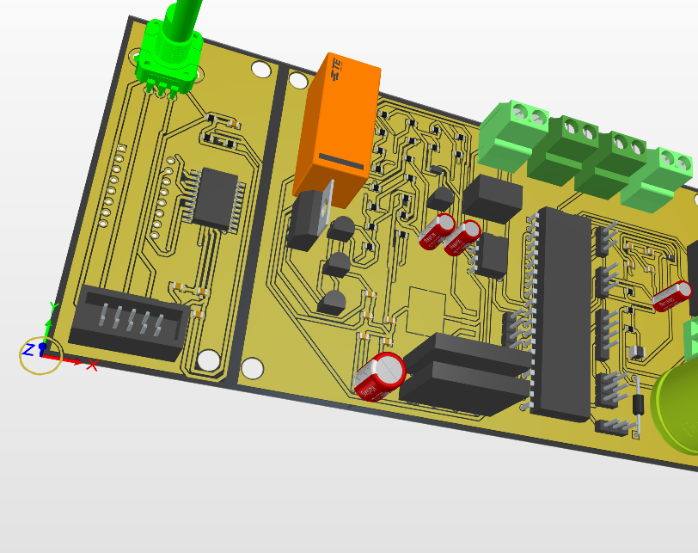
The PCB design
Notes:
After all of the Schematics are finished I was ready to design the PCB. This is also integrated in Altium so this step was very strait forward.
Split up into 2 smaller PCB’s
TO REDUSE MANUFACTURING COST
TO BE ABLE TO PUT THE DISPLAY IN A BETTER PLACE IN THE CASE + DISPLAY BOARD EXPLAINED
MAINBOARD EXPLAINED
FAIRLY EASY
AFTER MAKING SURE THE SETTINGS ARE CORRECT
PLACING THE COMPONENTS (COMPACT AS I COULD)

Slide 6
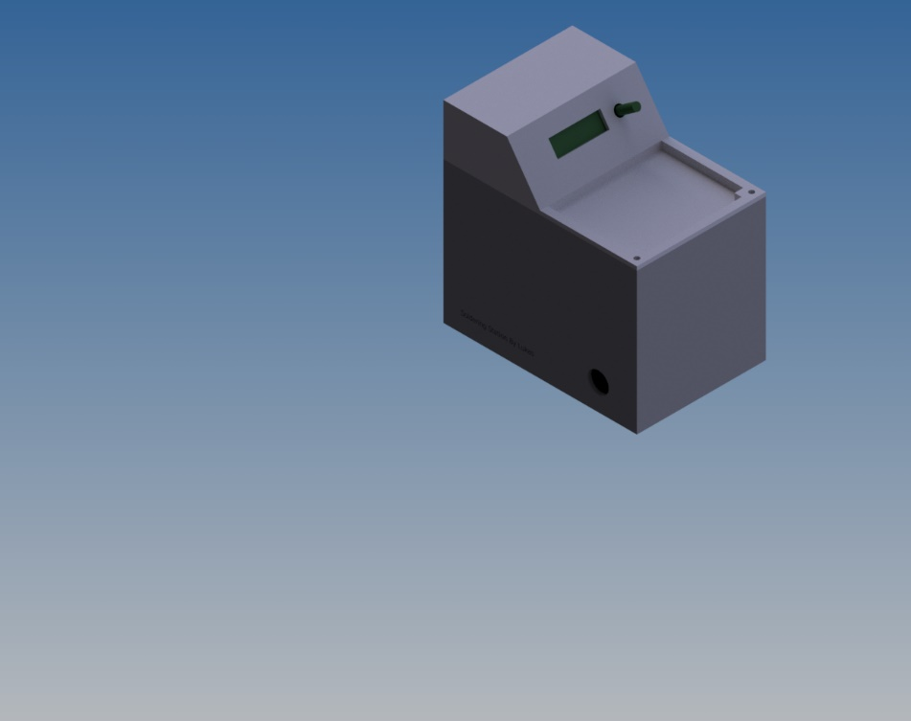
Mechanical design
Notes:
Functional and portable.
Cut-out on the top to make place for tools of sponge
Easy to read display
Connector on the left for left-handed users
3D printed out of pla

Slide 7

BUT WHERE IS IT?
Notes:
At the moment the station is not finished this is mainly because the pcb’s where ordered in group to reduce shipping costs.
Some of the members of this group had errors in their design that delayed the manufacturing process, this also delayed arrival by about a week.
Will be ready very soon.

Slide 8

Questions
Notes:
Thank you for your attention , if you have any questions feel free to ask them and I will do my best to answer them.

